Slide 1

Analog Strain Gauge on a CAN Interface
Jack Glennon, Dylan Nektalov, Alex Swartz

Slide 2
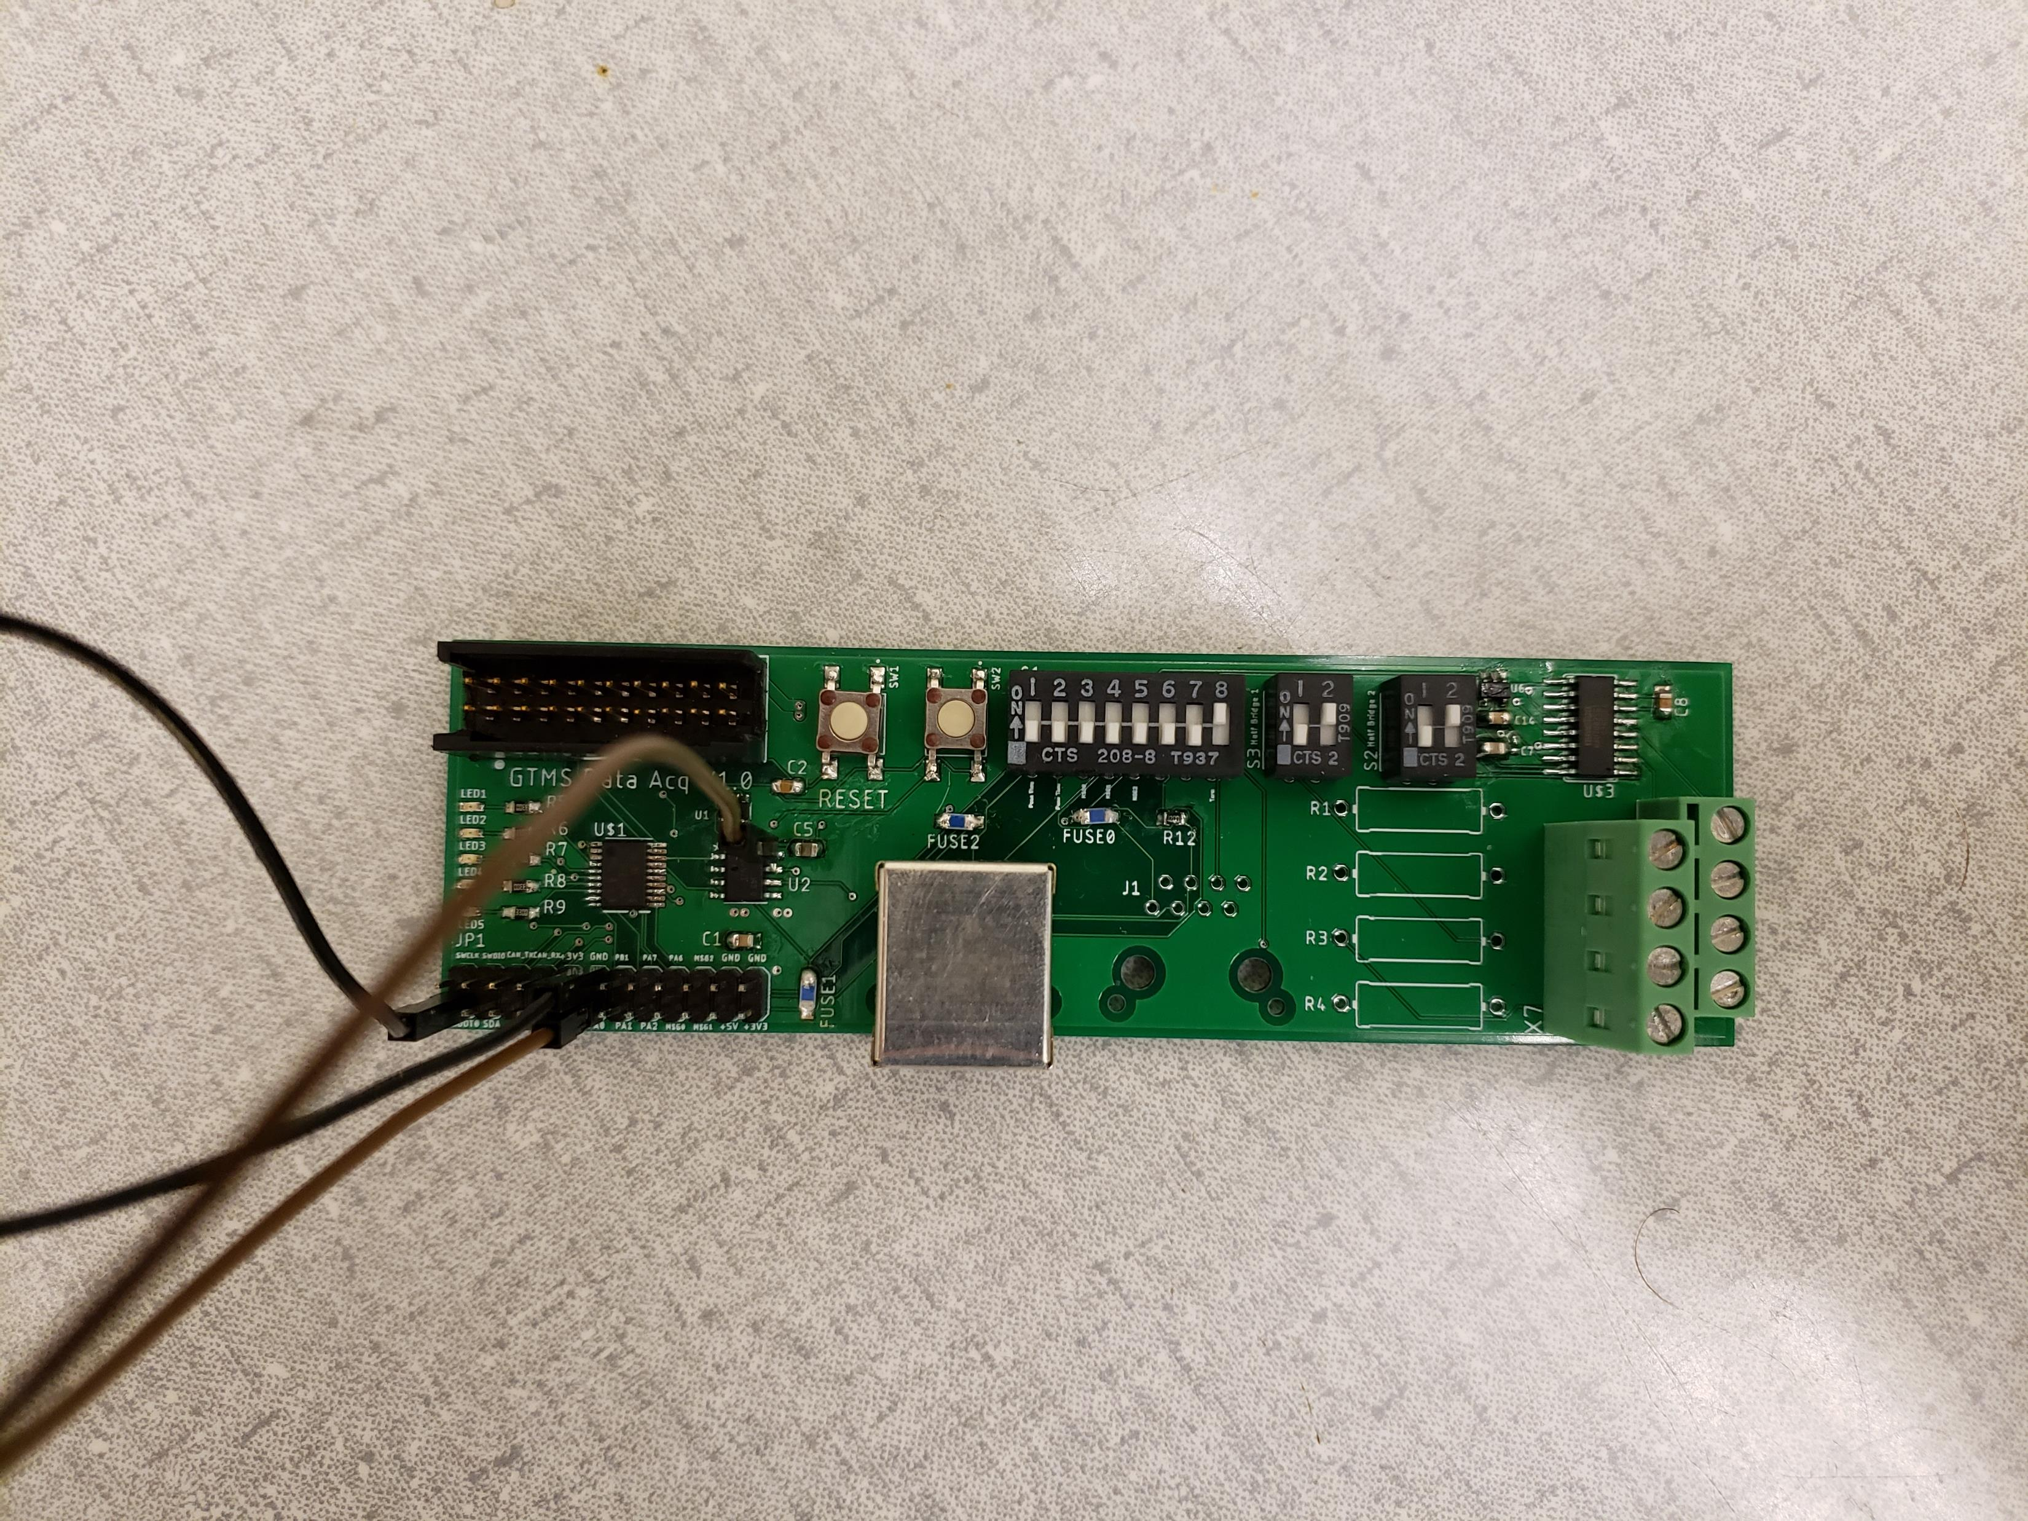

Project IDEA
Custom PCB to read analog strain gauge and transfer signals onto CAN bus
Measure forces on GTMS vehicle aero and frame elements
MBED for demonstration
Read CAN signals and display on PC terminal window
Parts
ST microcontroller, NAU7802 AD converter, NCV7349 CAN Tx/Rx, MBED, SK Pang CAN breakout board, CMOS low dropout regulator, capacitors, LEDs, resistors, switches, pins

Slide 3
Project Design
PCB
Strain Gauge
Analog to Digital Converter
ST Microcontroller
CAN Transceiver
Test Setup
CAN BUS
120 Ω
PC Serial Terminal
MBED
SK Pang CAN Breakout

Slide 4
Software
MBED C++ to display messages
CAN and SERIAL classes, ID filtering and masking, error handling
STM32 F042 (Cortex M0) for I2C, ADC, GPIO, Timing, and CAN function
ST hardware abstraction layer (HAL)
Custom ADC library
Keil uVision for debugging and an ARM compiler
Signal and power status LEDs through GPIO

Slide 5
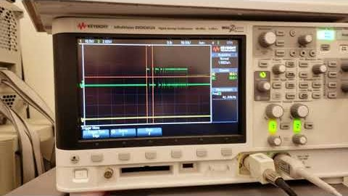
Demonstration

Slide 6
Summary and Future Work
Demonstrated ability to generate and read CAN messages
Compact, durable PCB suitable for use in formula-style vehicle
Enables GTMS team to monitor and compensate for stresses
Investigate MBED functionality challenges and implement broader filtering
Create revised PCB with CAN IC standby selection pin routed to microcontroller
DIP switch for Boot0 pin to eliminate jumper
Silkscreen for analog in header

